Slide 1

REVPASSWORD MANAGER
Secure Enterprise Password Vault System
Presented By: Sai Kumar
Md Saleem
Manideep
Anjan Kumar
Hemanth
Venkata Sai Reddy

Slide 2

PROBLEM
STATEMENT
01
Users manage multiple passwords across different platforms, and many reuse the same password for convenience. This creates major security risks because if one account is hacked, other accounts can also be exposed.
Storing passwords in plain text is unsafe and vulnerable to data breaches. Without encryption and centralized secure credential management, sensitive user information can be easily accessed by attackers.

Slide 3
02
PROPOSED
SOLUTION
Revature Password Manager Provides:
Secure user registration
AES-encrypted password vault
Two-Factor Authentication (2FA)
Security question recovery
Master password protection
Layered architecture design
Enterprise-level validation & security

Slide 4

SYSTEM ARCHITECTURE OVERVIEW
The system follows a Two-Application Architecture Model:
Frontend Application (Port 8081) – Handles UI and user interaction
Backend REST API (Port 8080) – Handles business logic and security
Oracle Database – Stores encrypted data securely
Communication happens using REST APIs with JSON format.
Flow:
Browser → Frontend → Backend → Database
This ensures separation between UI and core logic.
03

Slide 5
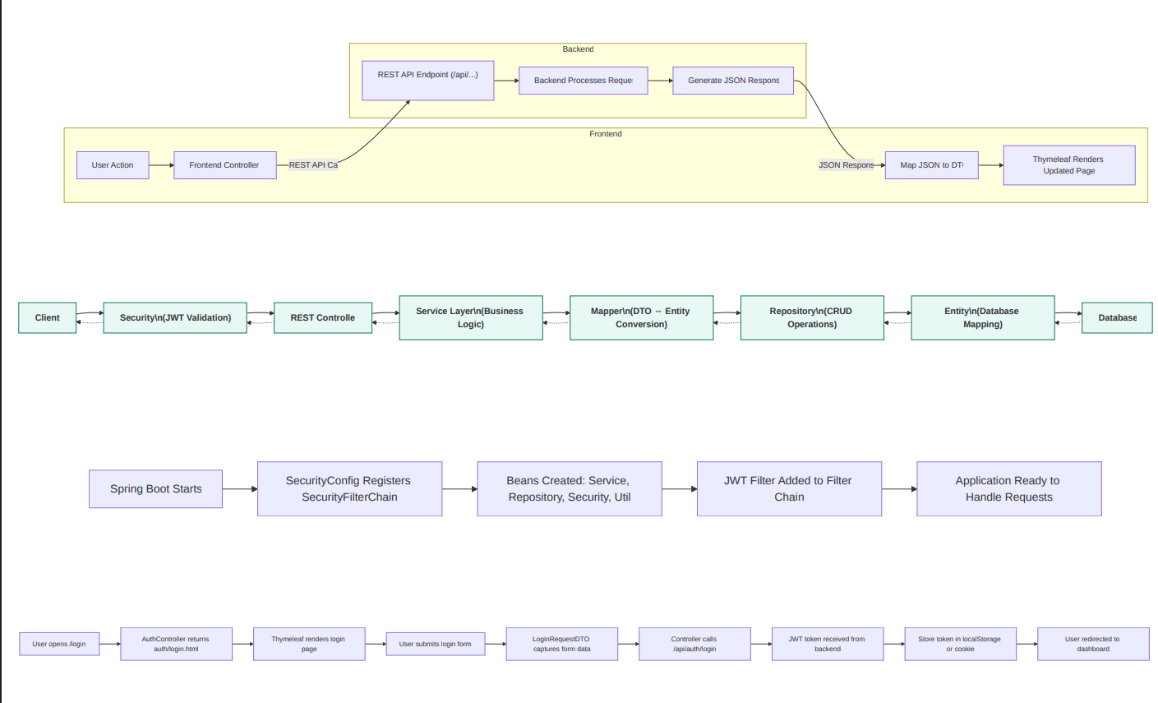
SYSTEM ARCHITECTURE DIAGRAM
Frontend to backend communication architecture
Layered backend architecture
Application startup flow architecture
04
Login page flow

Slide 6
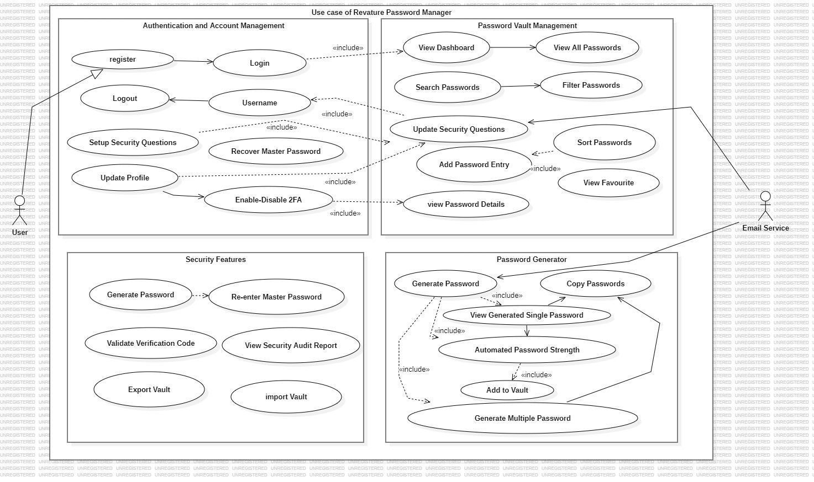
USE CASE DIAGRAM
05

Slide 7
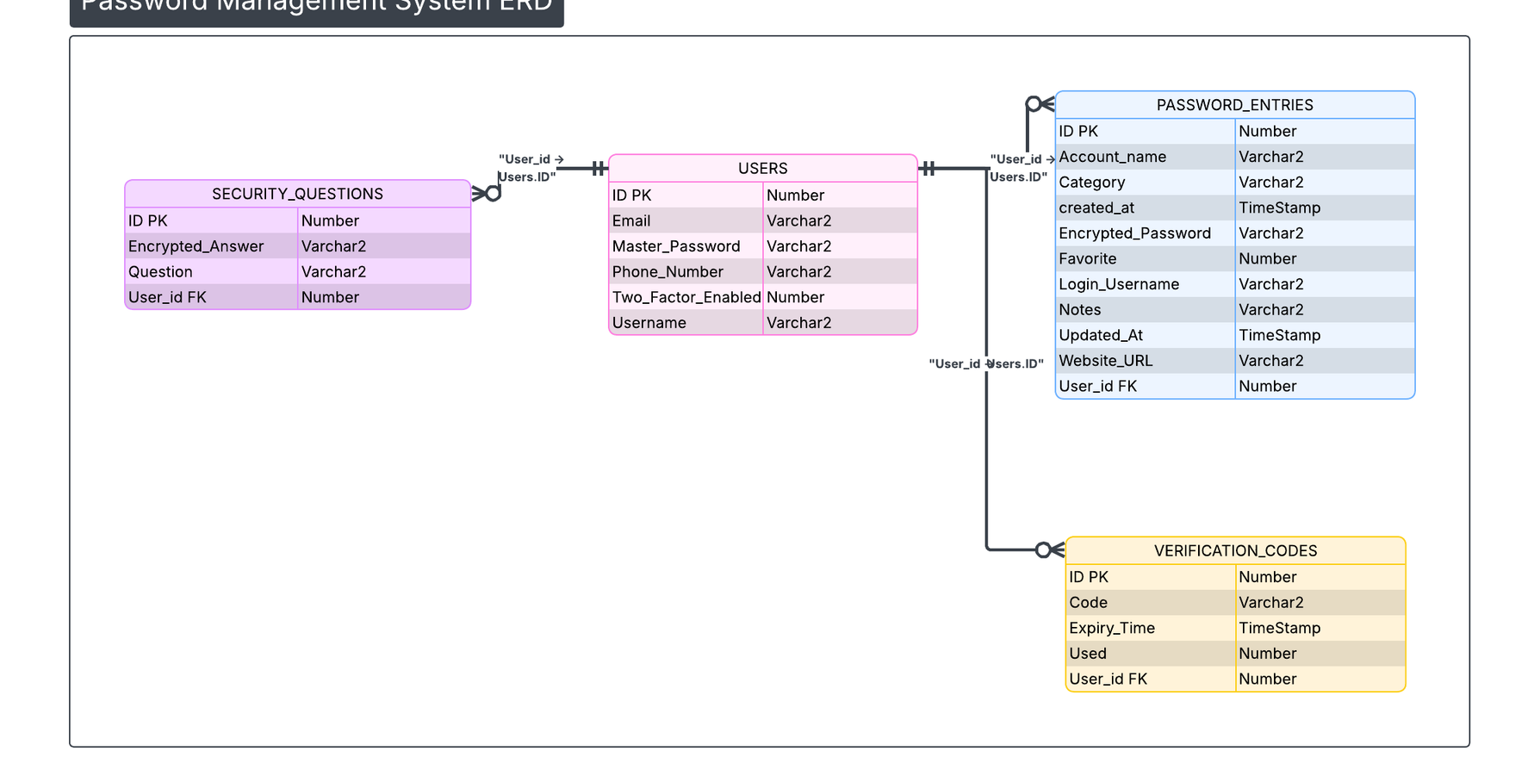
ER DIAGRAM
06

Slide 8

07
Frontend Application:
Built using Thymeleaf for dynamic UI rendering
Bootstrap used for responsive UI design
Client-side validation for better user experience
REST API calls made using RestTemplate
Backend Application:
• Controller Layer – Handles HTTP requests
• Service Layer – Contains business logic
• Repository Layer – Communicates with database
• JPA/Hibernate – ORM framework
• Oracle Database – Persistent storage
DETAILED ARCHITECTURE LAYERS

Slide 9
DATABASE DESIGN ENTITIES
Main Entities:
User – Stores user credentials and account details
SecurityQuestion – Stores recovery questions and hashed answers
PasswordEntry – Stores encrypted vault passwords
OTPVerification – Manages OTP generation and verification
Relational Mapping:
User (1) → (Many) PasswordEntry
User (1) → (3) SecurityQuestion
Studio Shodwe
Project.
08

Slide 10
09
Create Account
Allow users to register with email and secure verification, capturing basic profile and security preferences.
Store Credentials
Encrypt and store user credentials securely, supporting categorized entries and metadata tags.
A
D
Core Functional Requirements
Manage password
Enable users to organize, edit, share securely, and audit access to items within their vault.
B
Login
Provide multi-factor authentication options and secure session management for reliable user access.
E
Generate Passwords
Offer strong, randomized password generation with configurable length and complexity settings.
Secure Access
Implement role-based access control, session timeout, and breach detection alerts for protection.
C
F

Slide 11
SECURITY
IMPLEMENTATION
Security mechanisms implemented:
BCrypt hashing for storing master passwords securely
AES encryption for storing vault passwords
Two-Factor Authentication using OTP
Security questions for password recovery
DTO-level validation for secure API communication
Complete separation of frontend and backend
10

Slide 12
USER REGISTRATION FLOW
User enters registration details.
Frontend performs initial validation.
Backend validates input using DTO annotations.
Master password is hashed using BCrypt.
Security question answers are hashed and stored.
User data is saved securely in Oracle database.
11

Slide 13
LOGIN & OTP FLOW
User enters username and password.
Backend verifies hashed password.
If 2FA is enabled, OTP is generated.
OTP is verified within expiration time.
Session is created after successful verification.
User gains secure access to vault.
12

Slide 14
PASSWORD VAULT FLOW
User adds a new password entry.
Password is encrypted using AES before saving.
Encrypted value is stored in the database.
During retrieval, password is decrypted securely.
Raw encrypted values are never shown to the user.
13

Slide 15
PASSWORD
RECOVERY FLOW
User provides username or email.
System retrieves security questions.
Answers are verified using hashed comparison.
User sets a new master password.
New password is hashed and updated in database.
14

Slide 16
15
FEATURES
IMPLEMENTED
Secure User Registration
Login with OTP Verification
AES Encrypted Password Vault
Add / Update / Delete Password Entries
Profile Management
Master Password Change
Two-Factor Authentication
Password Recovery using Security Questions

Slide 17
VALIDATION STRATEGY
Frontend:
JavaScript-based validation
Custom error messages
Prevents unnecessary API calls
Backend:
DTO validation annotations
Global exception handling
Structured REST error responses
16

Slide 18
CHALLENGES
FACED
Handling backend validation errors in frontend
Managing OTP generation and expiration timing
Ensuring AES encryption consistency
Maintaining layered architecture separation
Designing responsive and validated UI
17

Slide 19
IMPROVEMENTS & FUTURE SCOPE
Email-based OTP delivery
Vault sharing between trusted users
Cloud deployment (AWS / Azure)
Docker containerization
Role-based access control
18

Slide 20
CONCLUSION
Revature Password Manager provides secure and centralized password storage with strong encryption mechanisms.
It follows a layered and scalable architecture with separation of concerns between frontend and backend. The system ensures secure authentication, encryption, and validation, making it production-ready and extensible.
19

Slide 21
THANK YOU

